Slide 1

Mentorness Internship Program
Project On:
Animation Movie Analysis
Created By:
Raja Barman

Slide 2

Hello Everyone, I am Raja Barman. I am a data analyst enthusiast. I got selected for Mentorness Internship program. Today I am here to discuss about my second project that is on Animation Movie data analysis. Let me give a brief intro about the project. We are given with data set having different movie name and their details like their name, language, budget, revenue, production company etc. We need to present a meaningful insights using power BI/Tableau. I am using Power BI. Let’s get started with the project.

Slide 3

Data Cleaning And Processing:
To get the meaningful insights, data cleaning is very much important. Here we have a column name Release_date which represent in which data movie got released. If we want to check the movies on the basis on year then we need to extract year from that column. So I have created a new column called year which contain year of movie release date. Also there are two column named Revenue and Budge. To get the profit, I have created a new column which will give me profit using those two column.

Slide 4


Let’s have a look at our KPIs:
According to the data that we have our KPIs would be Total Budget, Total Revenue, Total profit, Total vote and Average vote across different type of genres, different language etc.
So I have created four slicer which we can use to filter data. Those four slicer are Genres, Original Language, Movie Release year and Movie status. Using those filters we can easily get the data that we need.

Slide 5

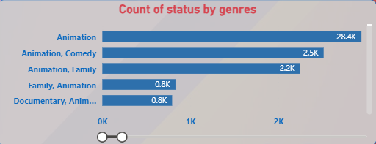
Insights On Different Genres Movie
Here we represented different Genres movie count in a bar graph which helps us to understand which kind of movies are available more in numbers.

Slide 6

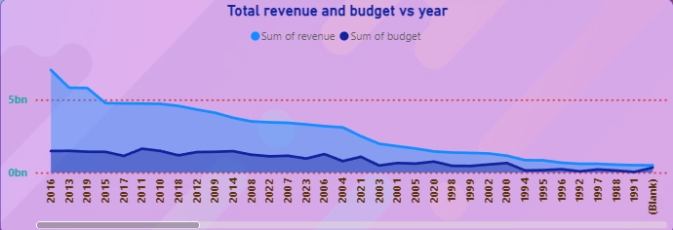
Total Budget and Revenue map in every year
To check the budget and revenue trend line we have created an insight which will show the difference in budget and revenue in every years.

Slide 7

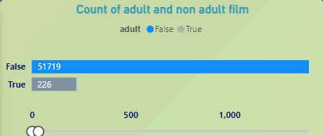
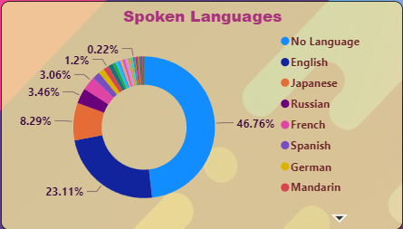
We Have created two other insight to check out the total number of movies made in different language and how many movies are adult movie and how many are not.

Slide 8

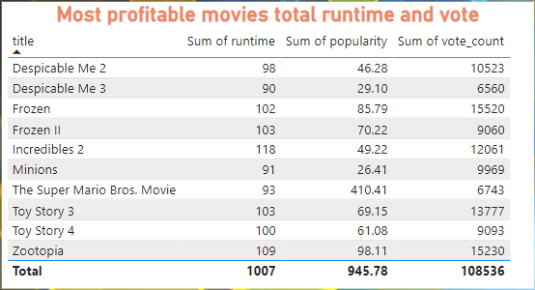
Most Profitable Movies and their run time
I have created a table to check out the most profitable movies and their run time along with the popularity and total votes they got. Here we can see the results.

Slide 9

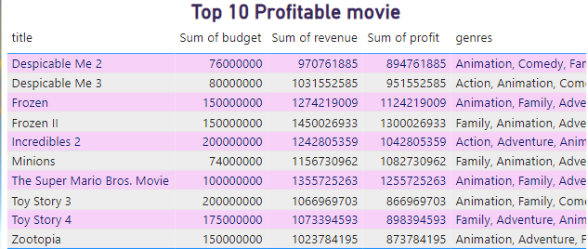
Top profitable movies and their genres
To check the relation between profit and genres I have created a table of top 10 profitable movie, containing budget, revenue, profit and genres. Here is the result

Slide 10

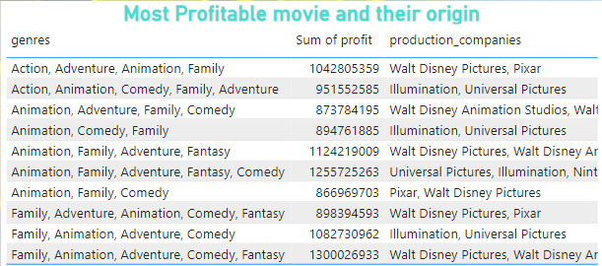
Finding Most Profitable Movie and their origin
To know that origin and the production company I have created another table with genre, Profit, Production company and Production country. Here is the result.

Slide 11

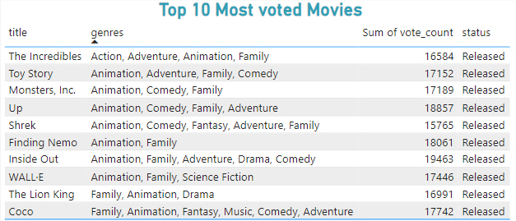
Finding the genres and title of most voted movie
Let’s check out the top 10 voted movies name and their genres. To check that I have created a table as we can below. Using this we can understand which kind of movie people will like.

Slide 12
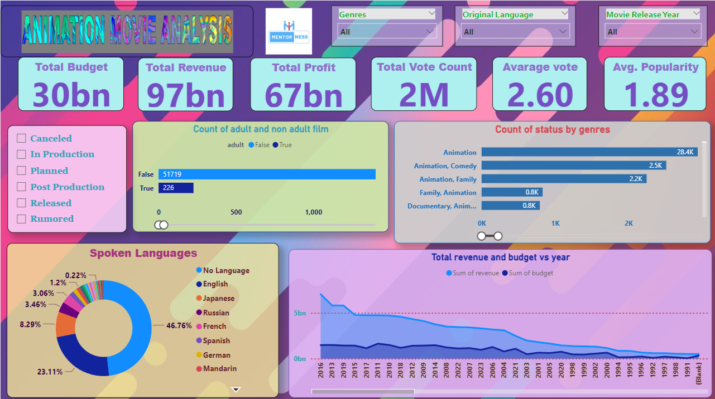
Let’s have a look at our entire dashboard:

Slide 13
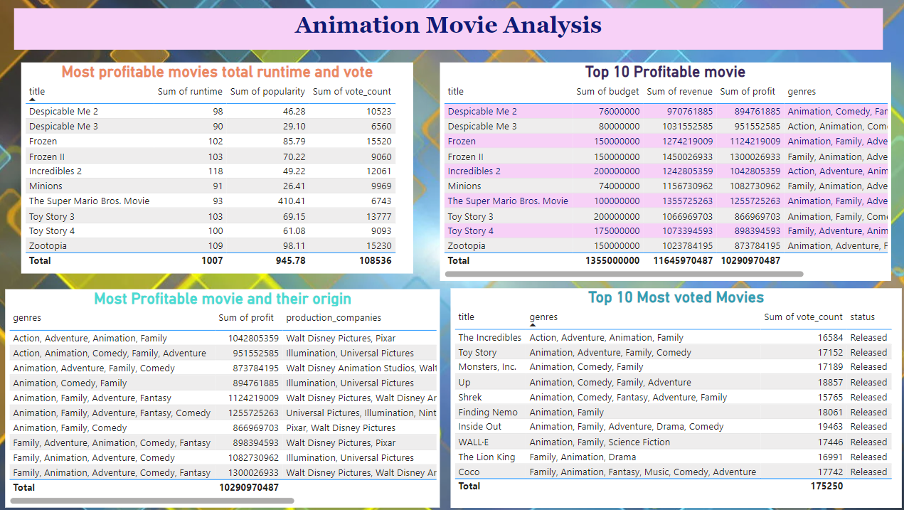
Let’s have a look at our entire dashboard:

Slide 14


